Slide 1
Image Processing Application Deployed in AWS
Antonino Rando
2024/25

Slide 2
Work Outline
App local development
API deployment
API gateway
Test
EC2 instances

Slide 3
Lambda Deployment

Slide 4


App Local Development
Application capabilities: convert colored images into single-tone images
Technologies: Python, PILLOW
Source code: https://github.com/AntoninoRando/AWS-Lab

Slide 5
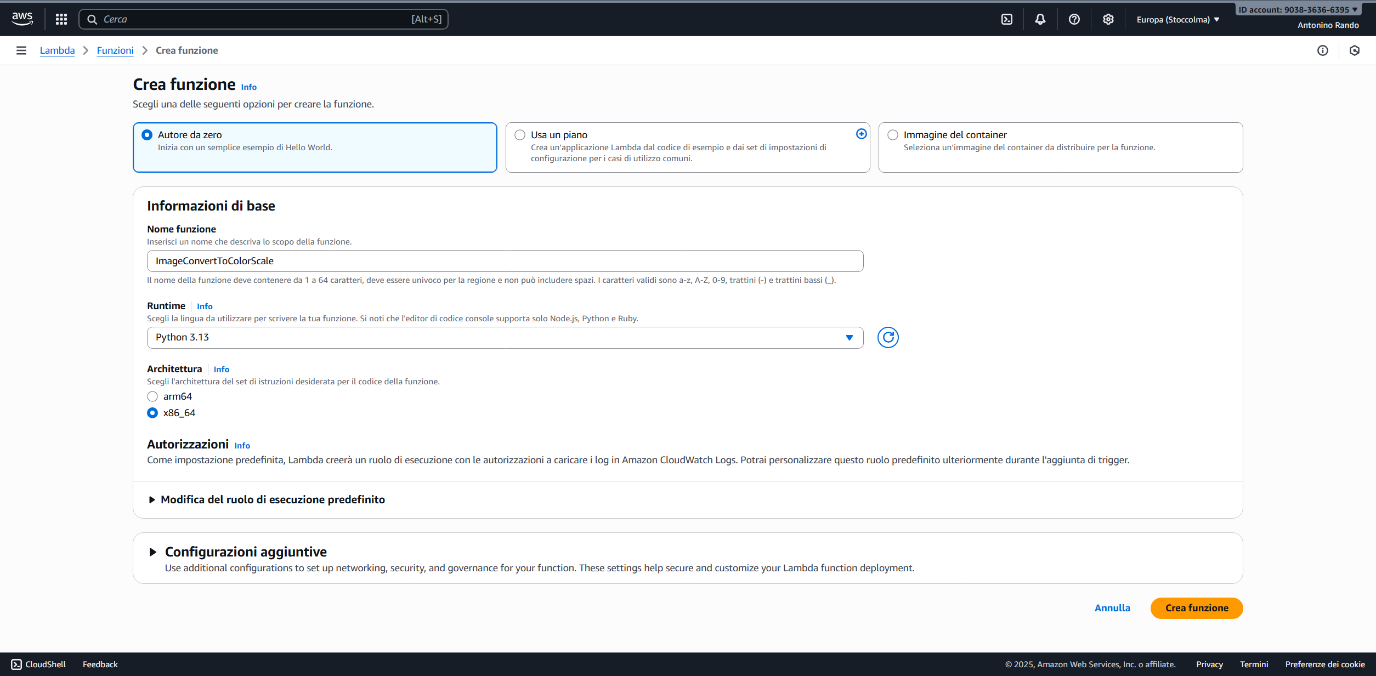
API Deployment Lambda Creation

Slide 6
API Deployment Lambda Layers
Since the application was built using Pillow, It has to be loaded on a lambda layer
I've tried 2 approaches for building the lambda layer:
  Using a custom zip layer
  Using an ARN (Amazon Resource Name): unique identifiers of AWS resources (arn:aws:lambda:eu-north-1:770693421928:layer:Klayers-p312-pillow:2)
    Only works with Python 3.12 runtime
Setup runtime environment for Python
Install Pillow via pip
Gathered the installation inside a zip
Loaded the zip on an s3 bucket
Built a lambda layer from that bucket

Slide 7
API Gateway
Created REST API
Choose POST method using the lambda
Modified API settings to support multimedia content
Gathered the URL for invocation (during tests)

Slide 8
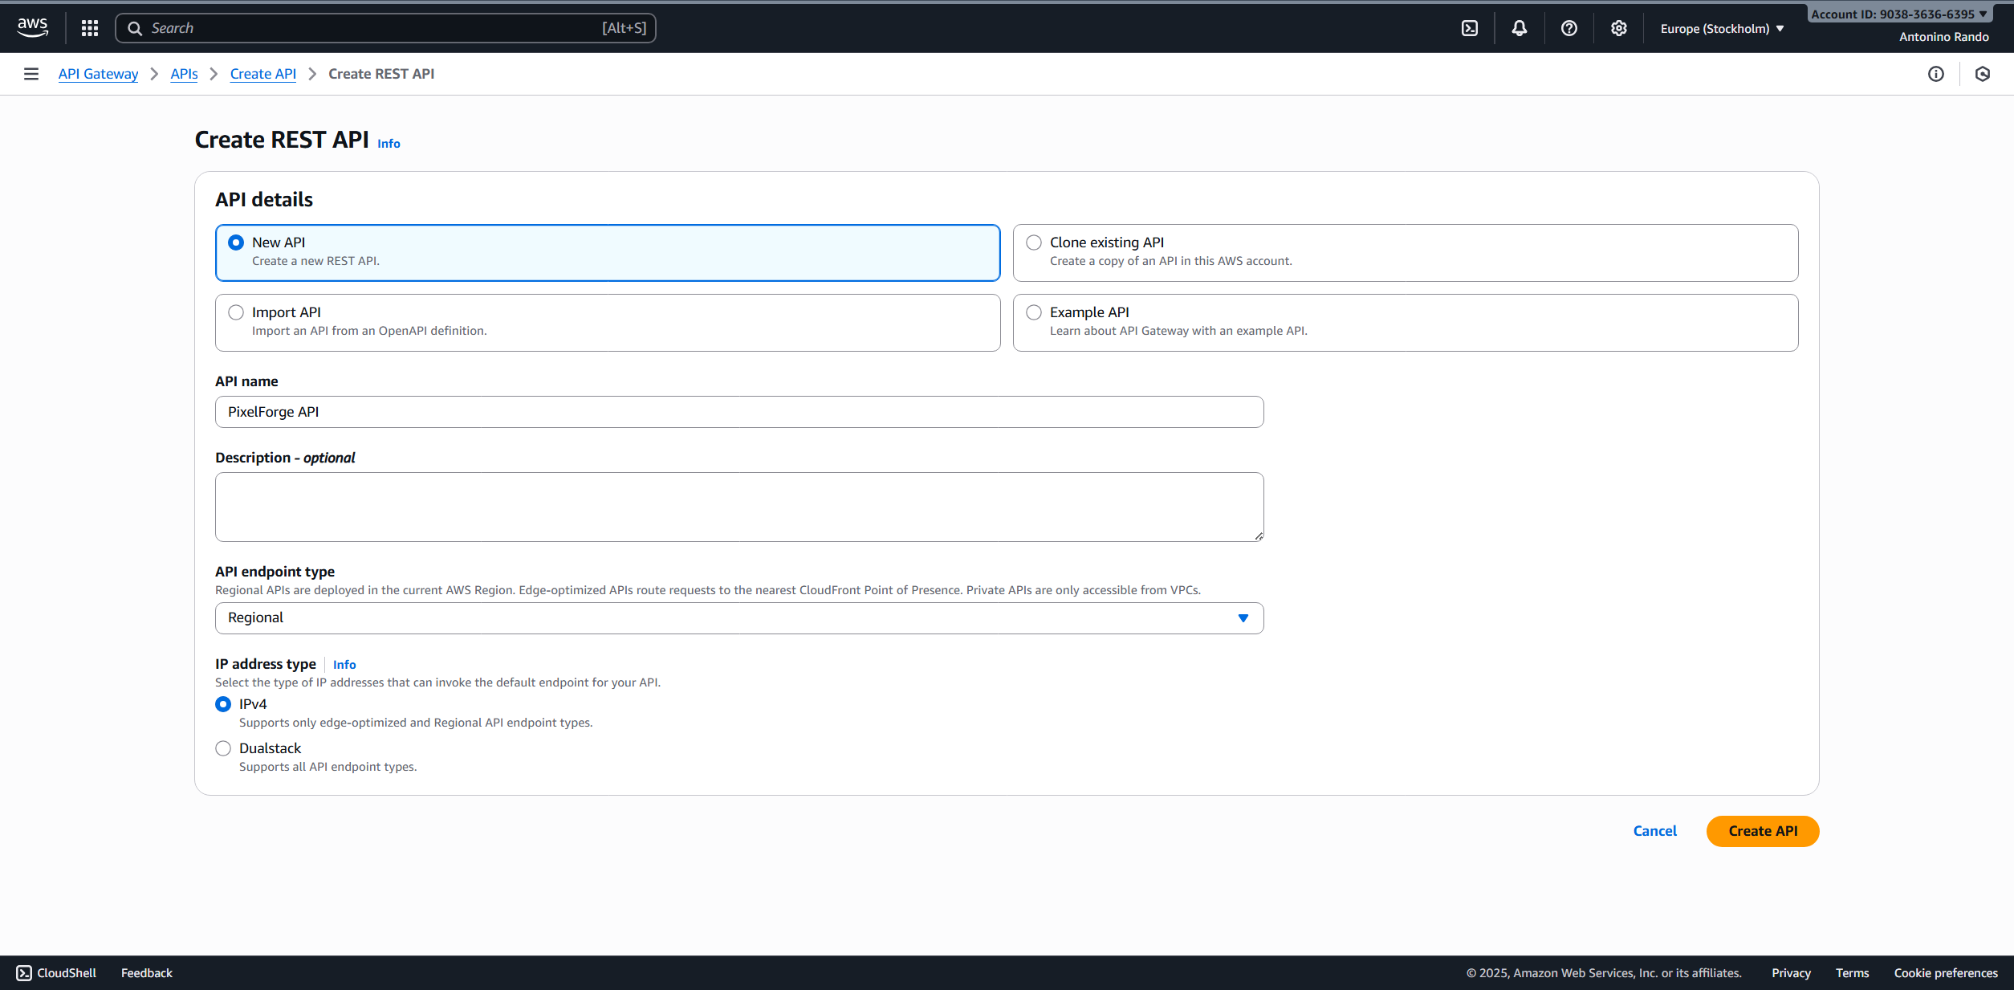
API Gateway

Slide 9
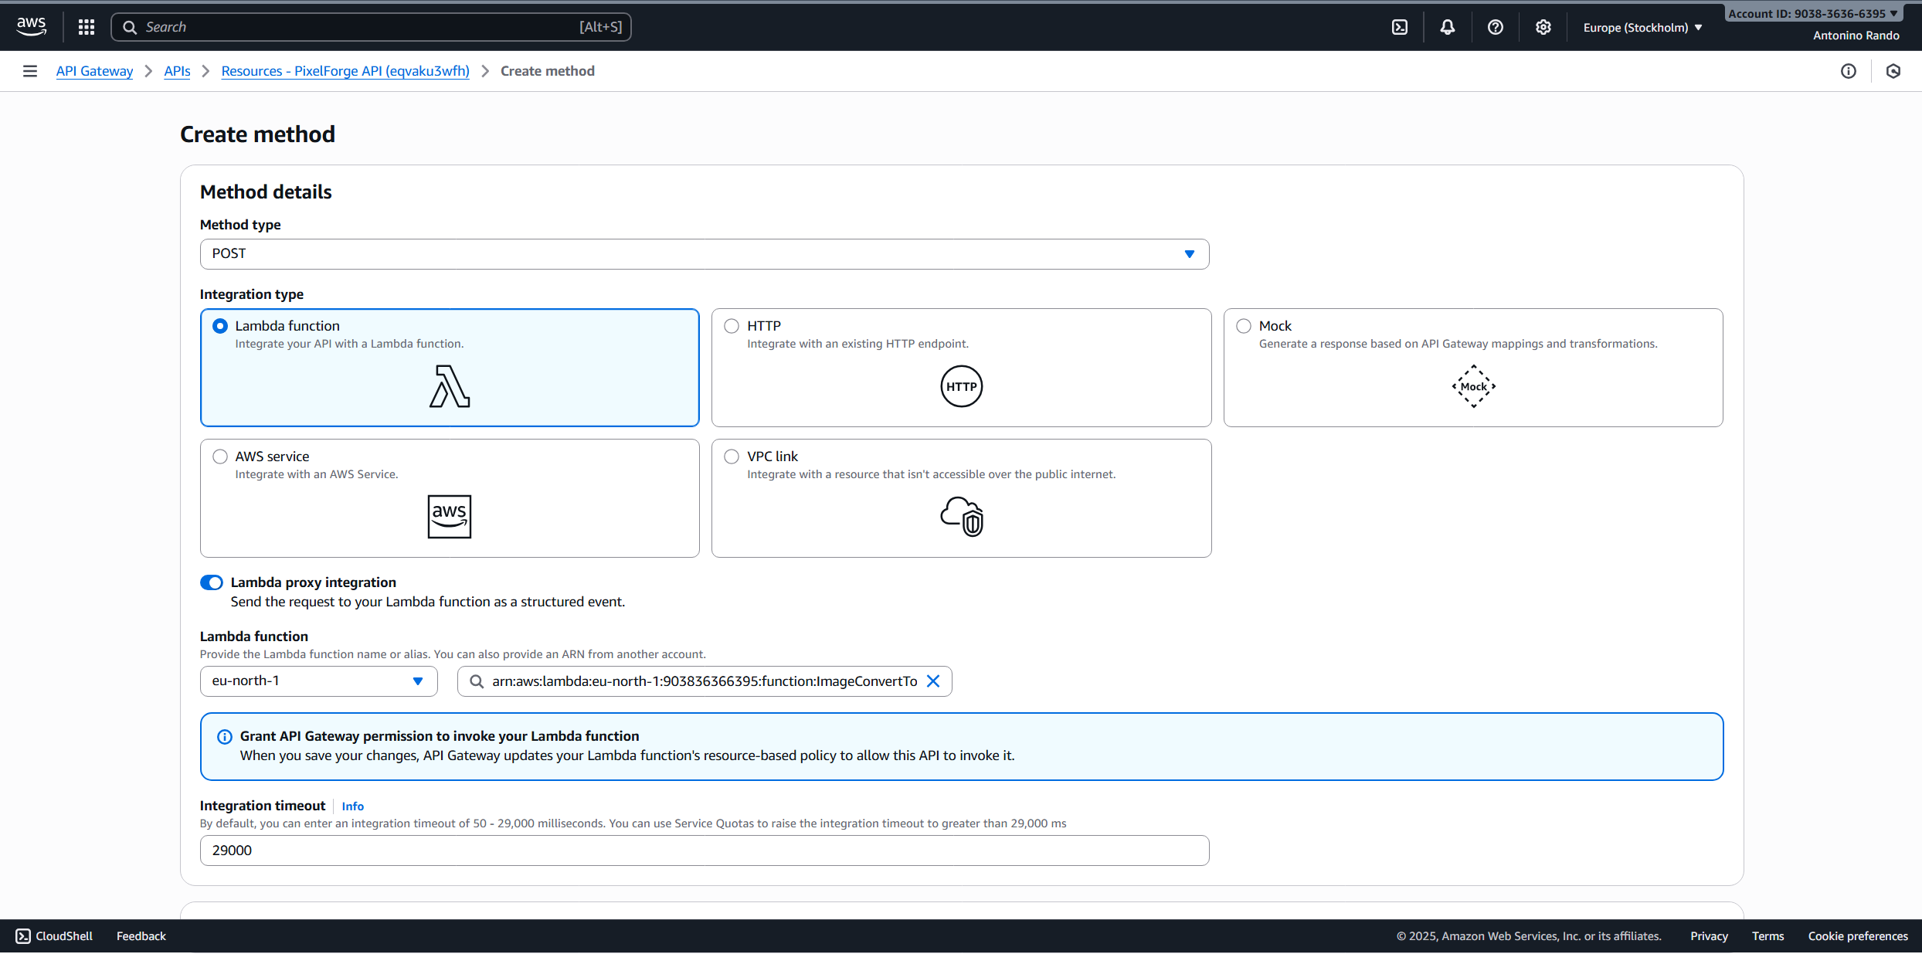
API Gateway

Slide 10
Testing the Lambda

Slide 11
Test Plan
Setup two EC2 instance with different types
Install Apache Jmeter on both instances
Run tests comparing how the lambda performs in both cases
The EC2 instances used for test are
t3.micro (the smallest available)
m71-flex.large (the biggest available with my free account)

Slide 12
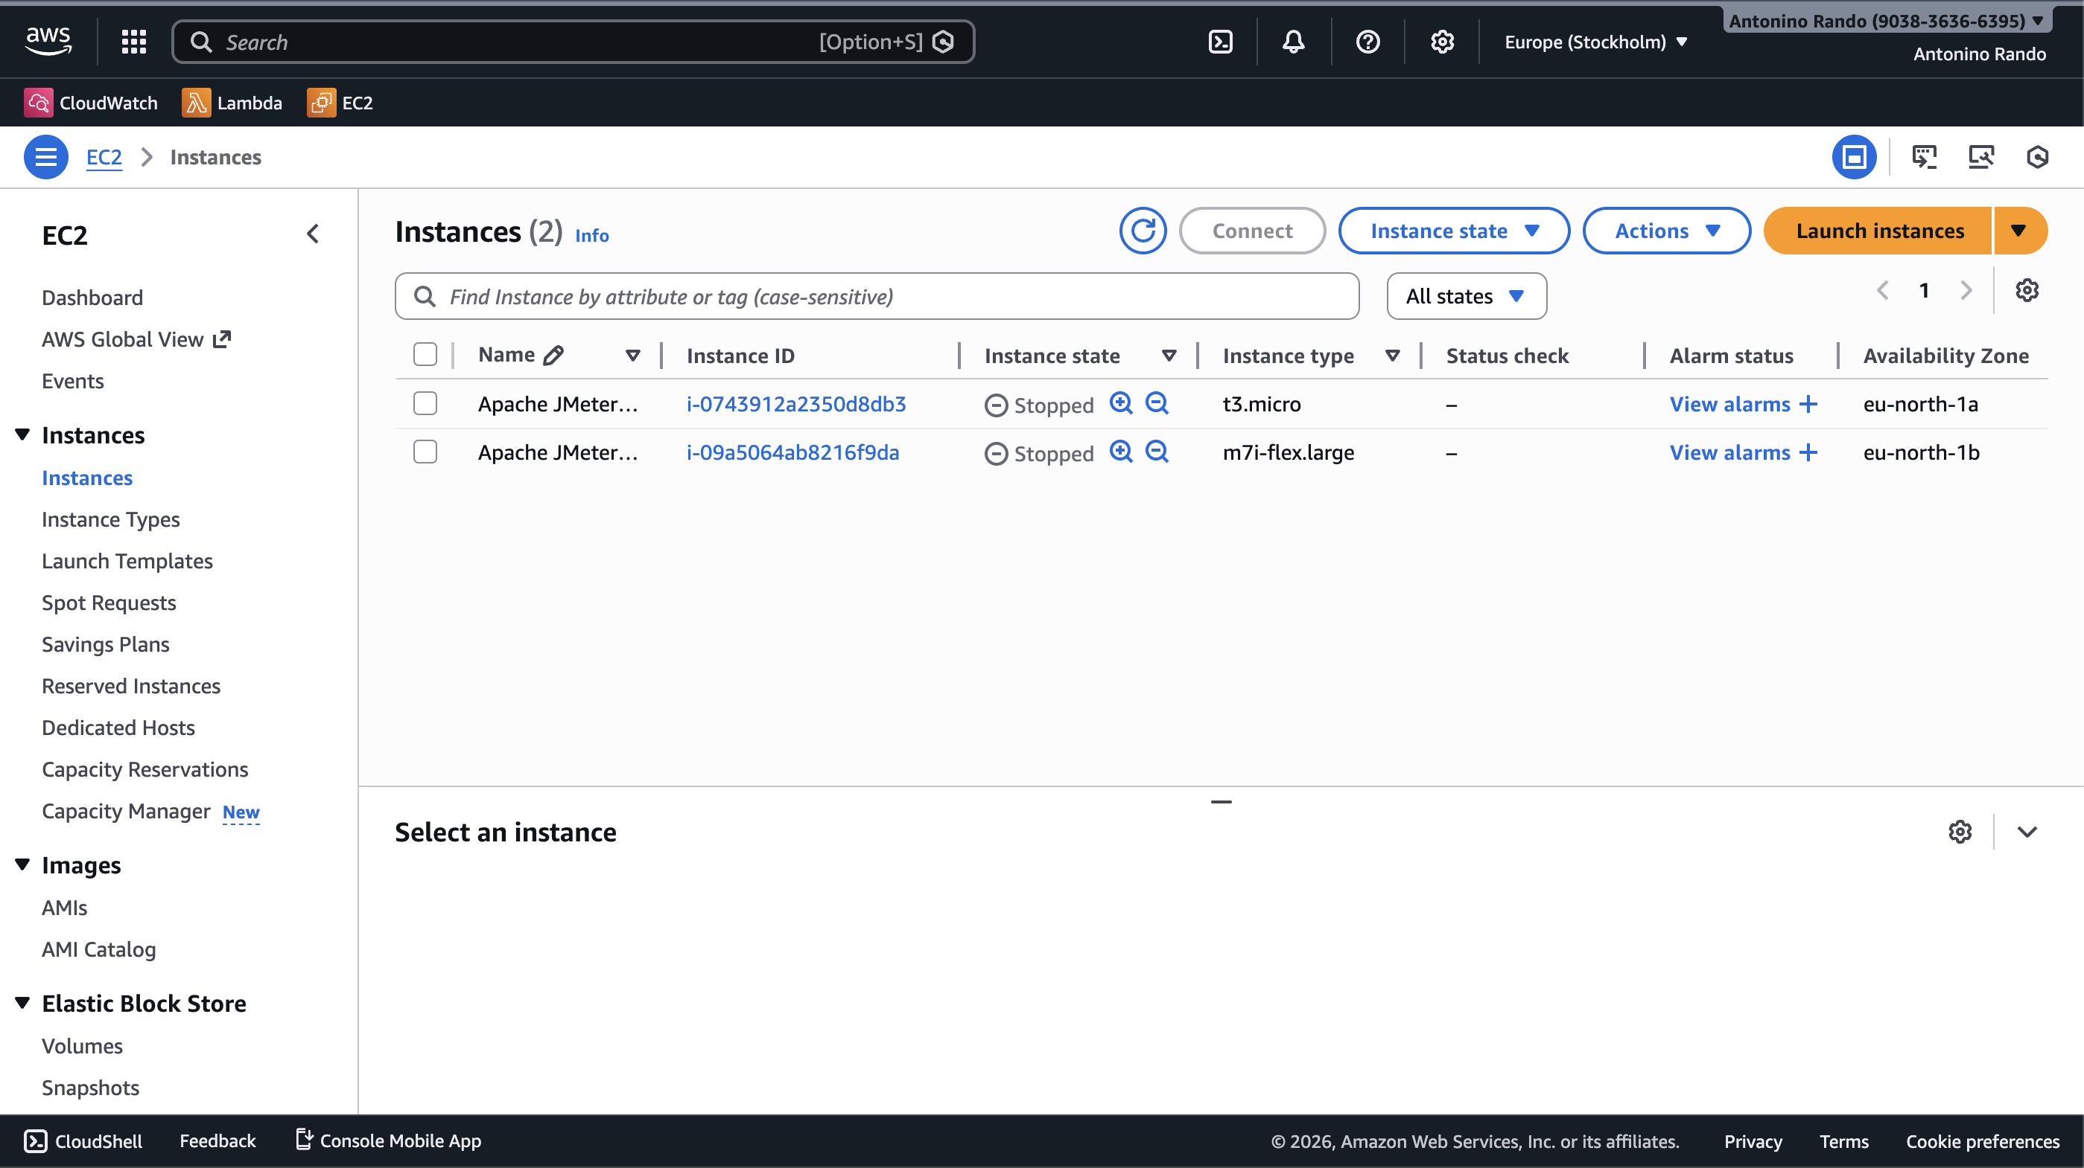
EC2 Instances

Slide 13
EC2 Instances Details
Both instances shares these details:
OS: Amazon Linux (Amazon Linux 2023 AMI 2023.10.20260105.0 x86_64 HVM kernel-6.1)
Key-pair (used for authentication): RSA
SSH traffic allowed from anywhere (only for test purposes)
Storage: 1 volume of 8 GiB gp3 (General purpose SSD), 3000 IOPS (Input/Output operation per seconds), not encrypted

Slide 14
EC2 Instances Apache JMeter Setup
Download JMeter locally
Configure test via UI
Connect to EC2 instances via SSH
Download JMeter on instances
Load local files into the EC2 instances
Make .csv test payloads

Slide 15
EC2 Instances Shell Script for JMeter
sudo yum update -y
sudo yum install java-11-amazon-corretto -y
sudo wget https://archive.apache.org/dist/jmeter/binaries/apache-jmeter-5.6.3.tgz
sudo tar -xzf apache-jmeter-5.6.3.tgz
sudo chown -R ec2-user:ec2-user jmeter
echo 'export PATH=$PATH:/opt/jmeter/bin' >> ~/.bashrc
source ~/.bashrc

Slide 16
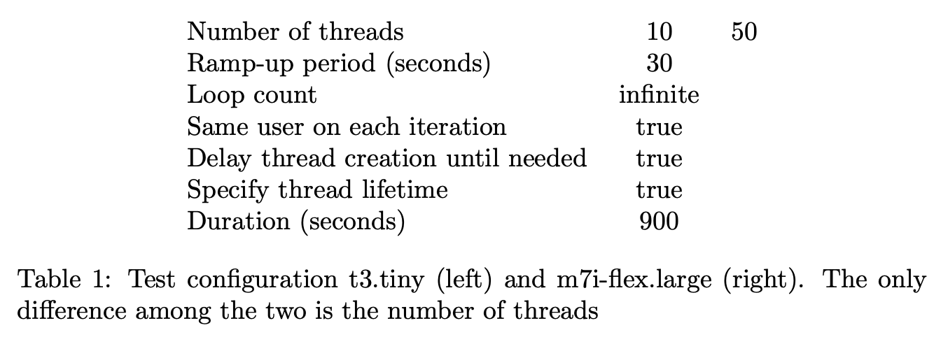
Test Configuration JMeter

Slide 17
Test Configuration Test Payloads
About 20 images
From 25x25 up to 8k
Gathered as base64 inside a CSV file

Slide 18
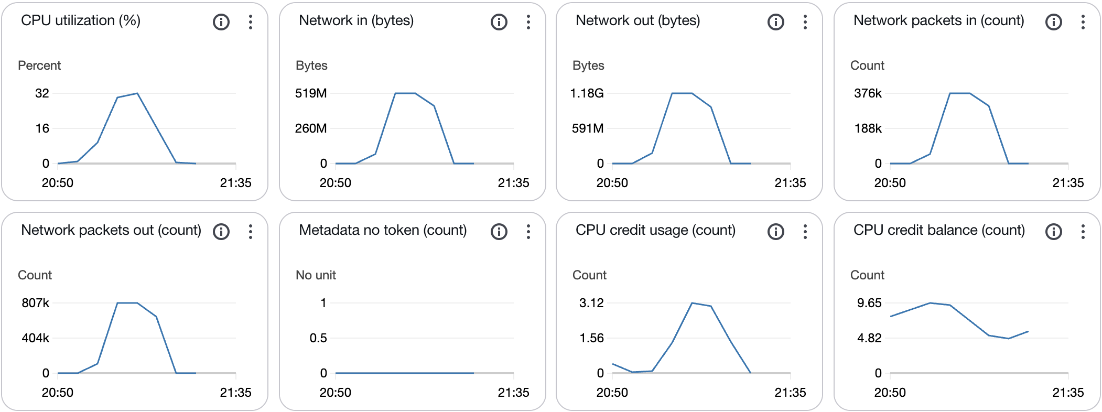
Results t3.tiny EC2 metrics

Slide 19
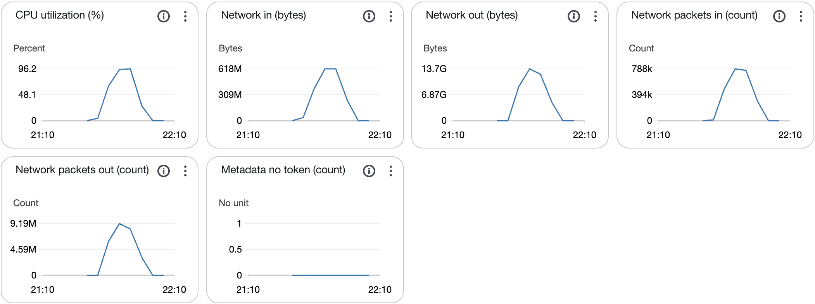
Results m71-flex.large EC2 metrics

Slide 20
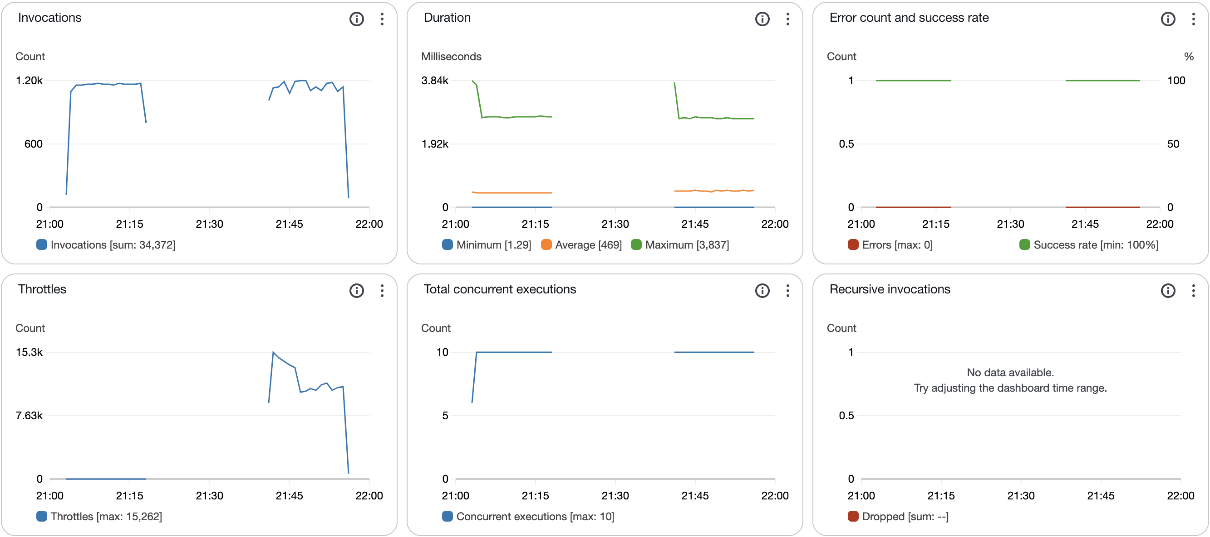
Results Lambda Metrics (t3.tiny on the left, m71-flex.large on the right)

Slide 21
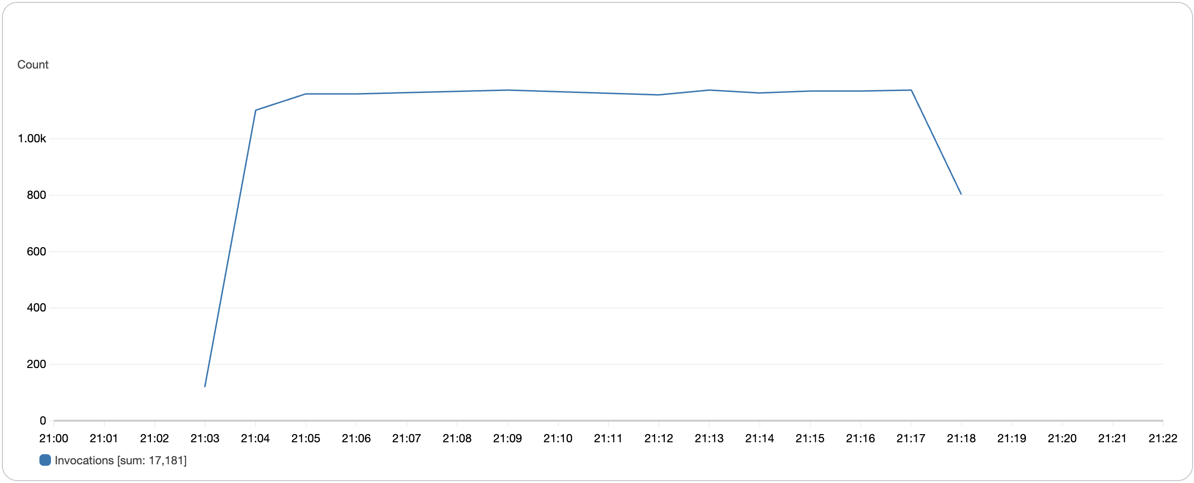
Invocations t3.tiny

Slide 22
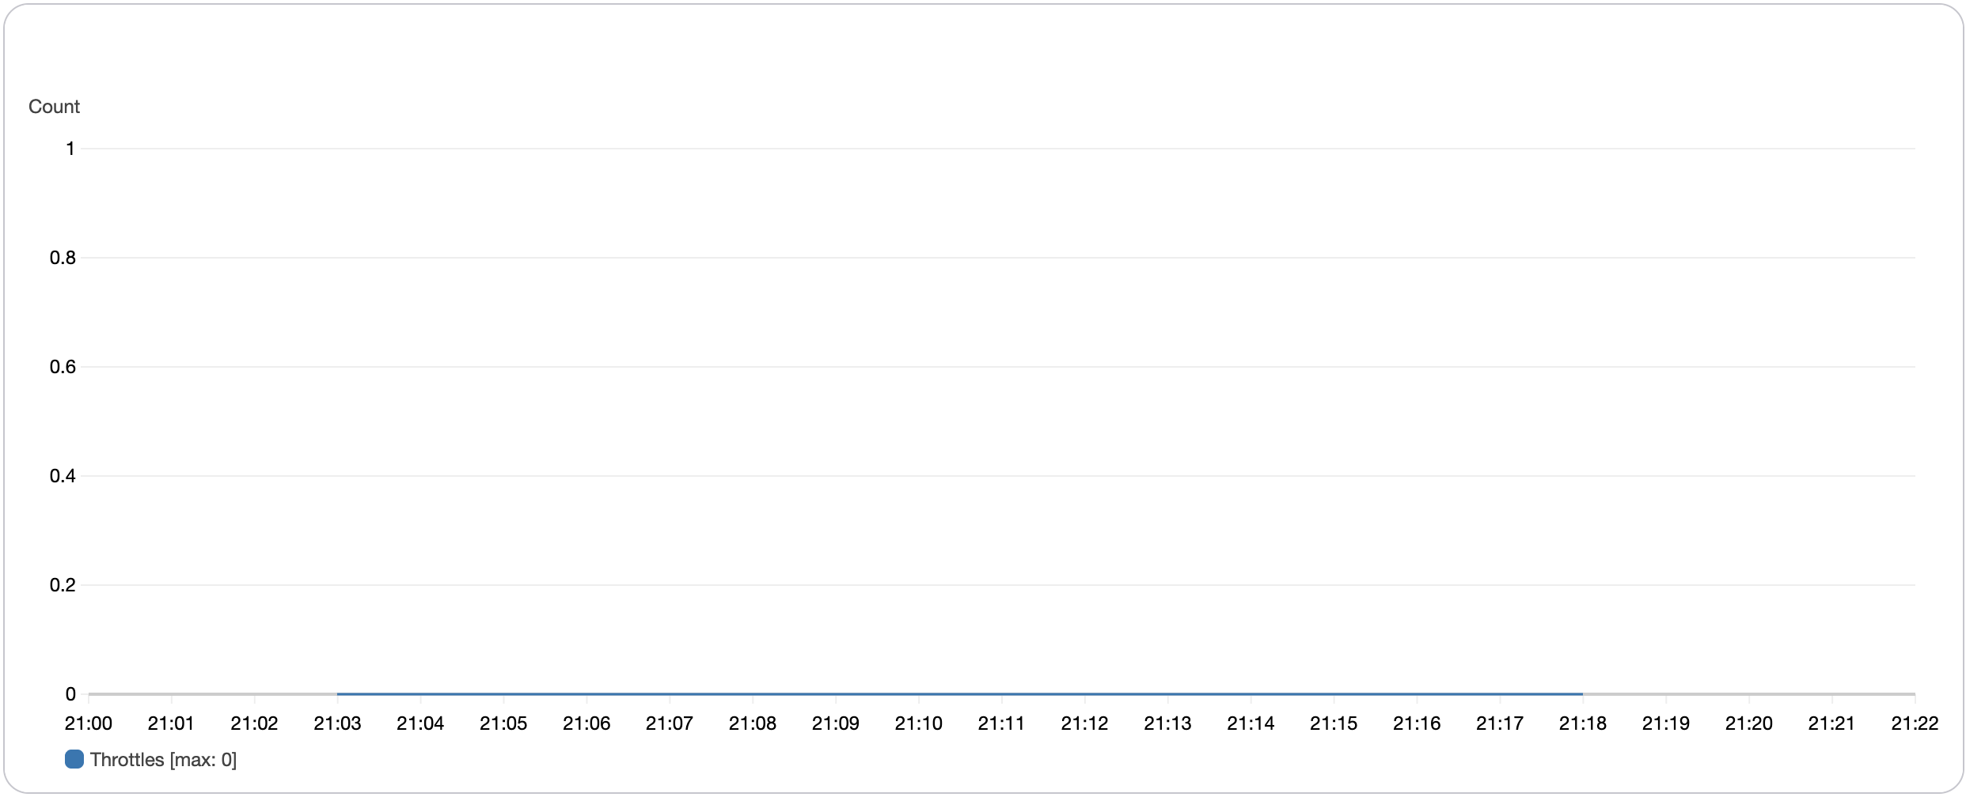
Throttles t3.tiny

Slide 23
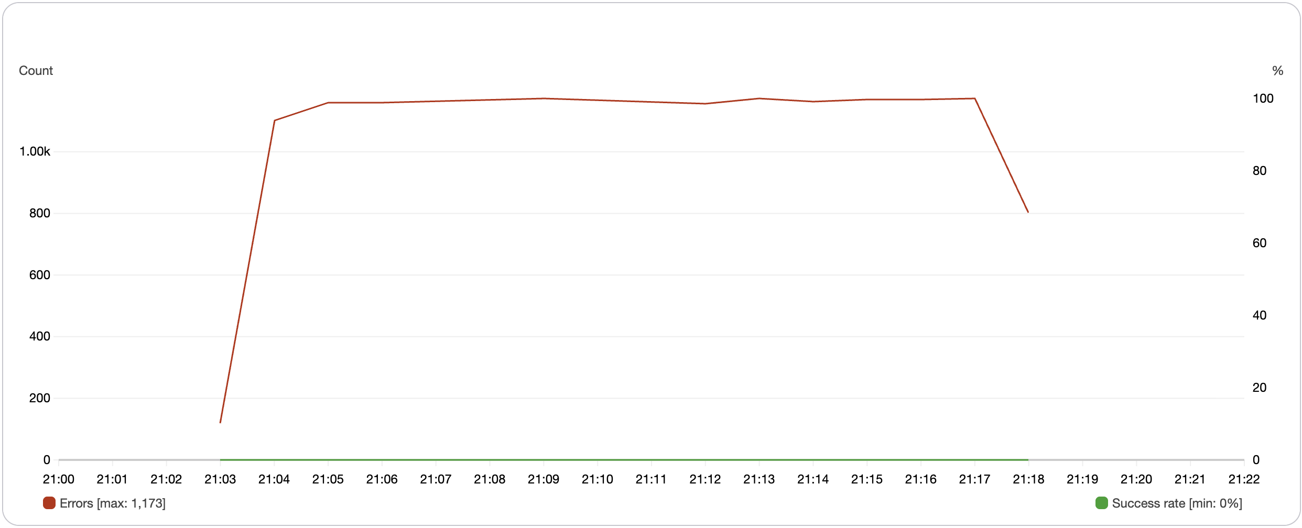
Errors (sample count) t3.tiny

Slide 24
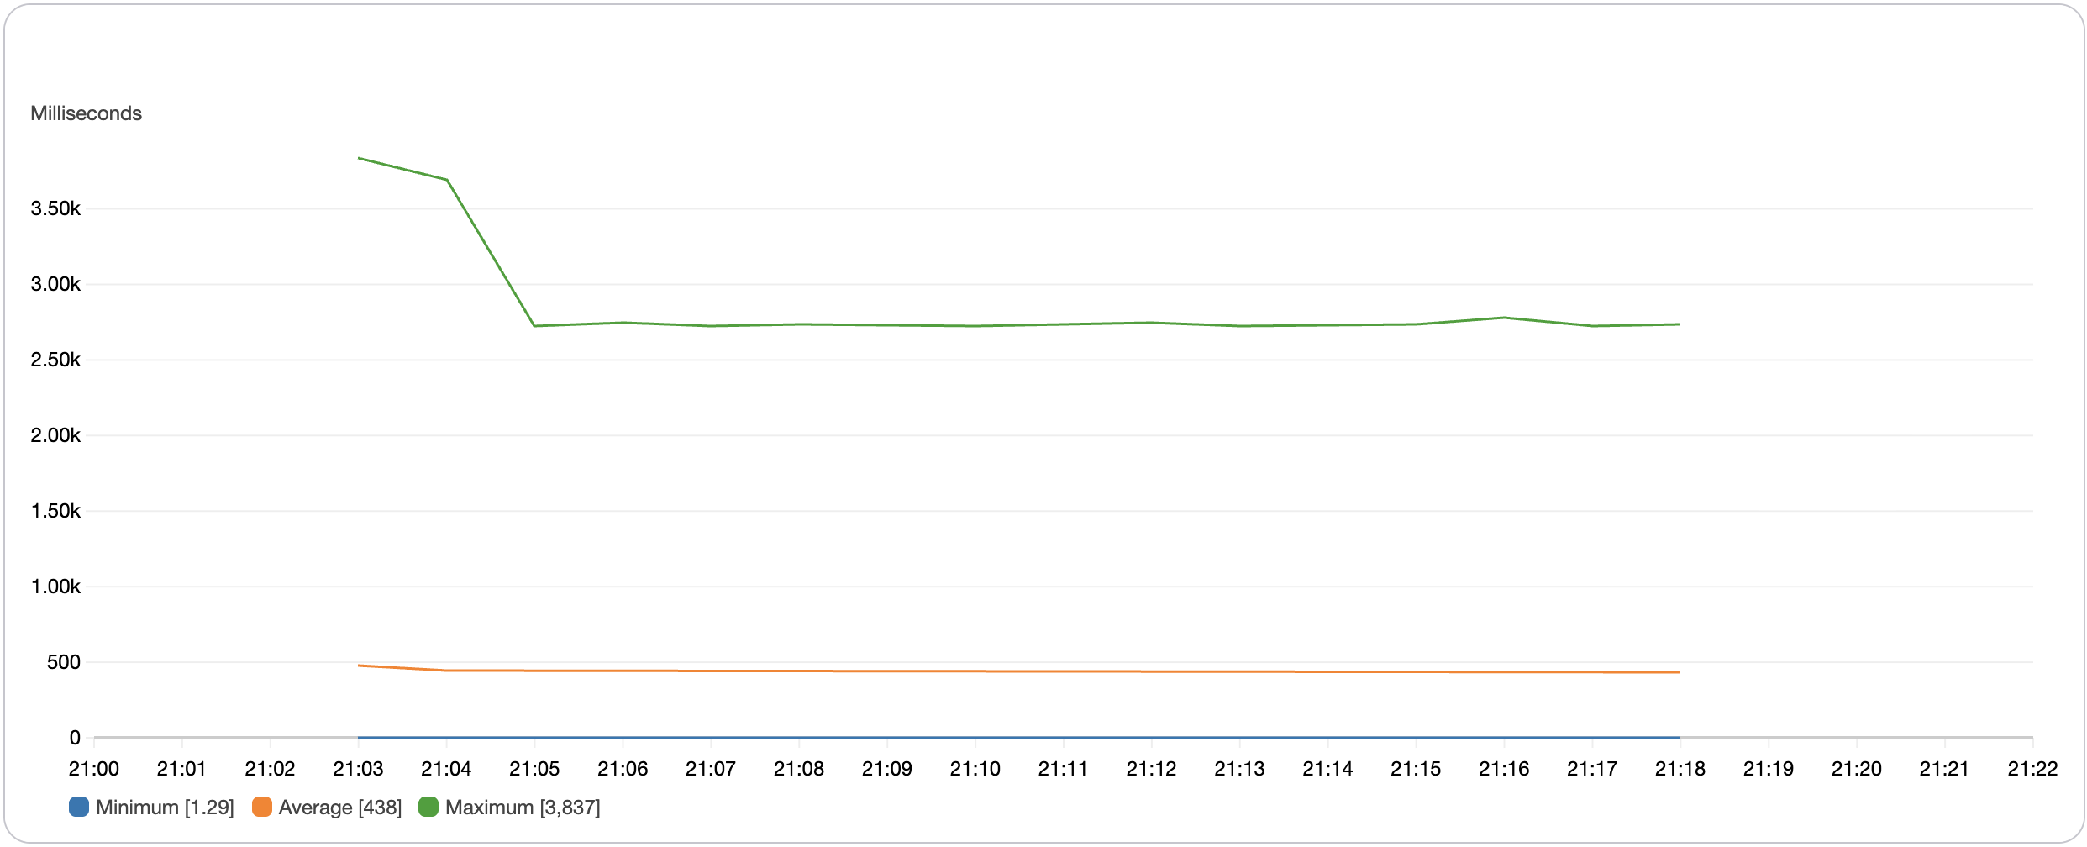
Duration t3.tiny

Slide 25
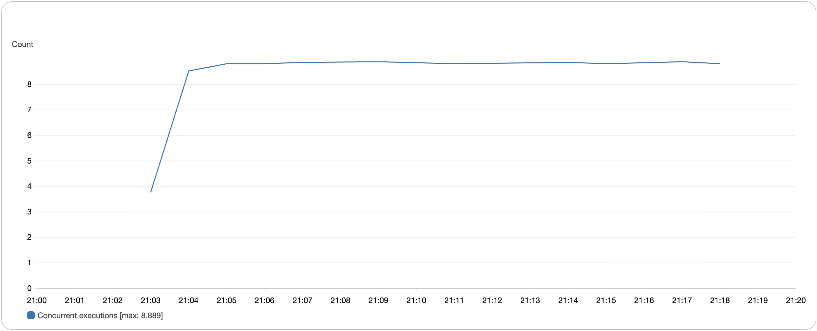
Concurrent Executions t3.tiny

Slide 26
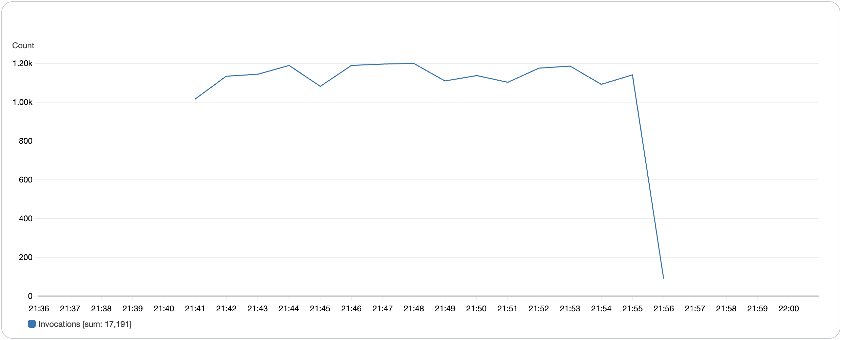
Invocations m71-flex.large

Slide 27
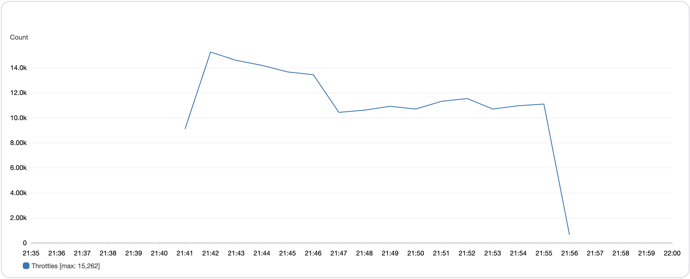
Throttles m71-flex.large

Slide 28
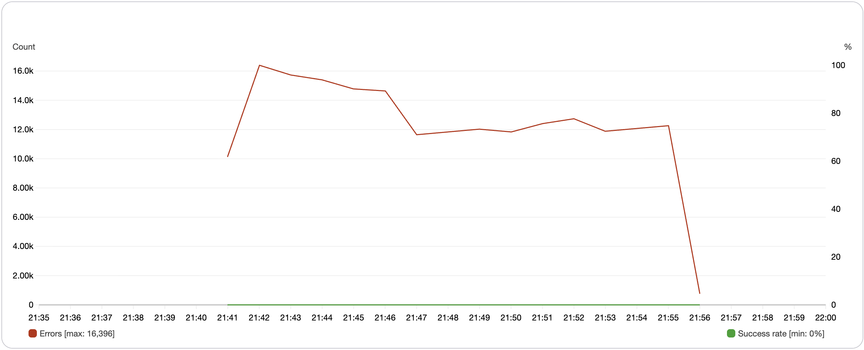
Errors (sample count) m71-flex.large

Slide 29
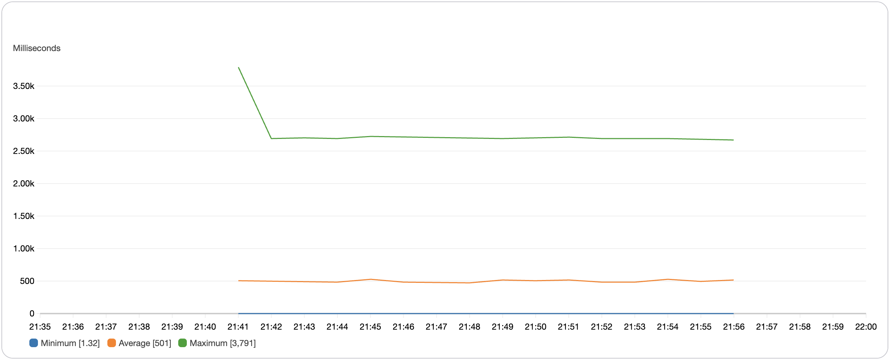
Duration m71-flex.large

Slide 30
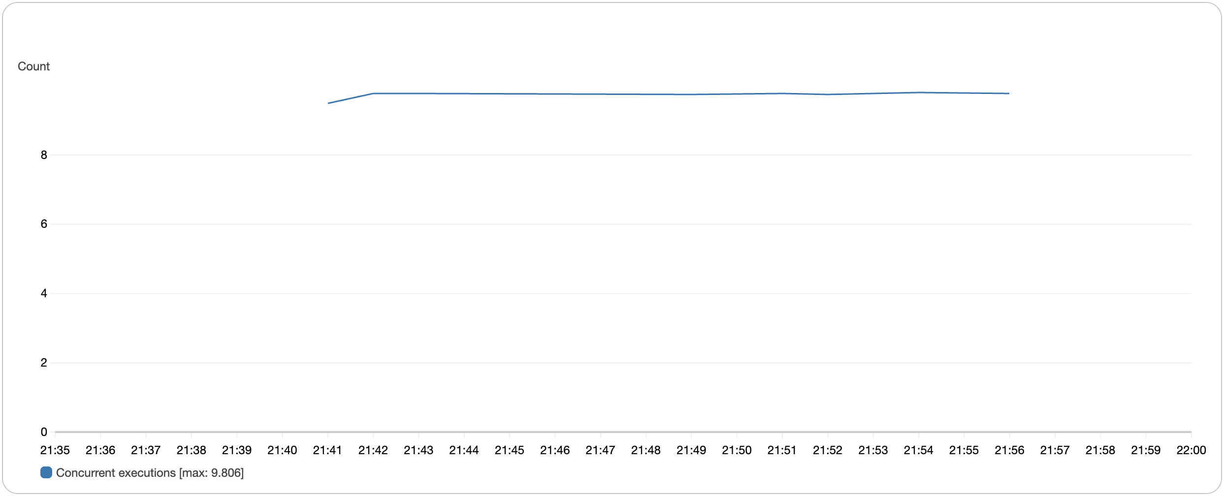
Concurrent Executions m71-flex.large

Slide 31
Thanks

